Slide 1
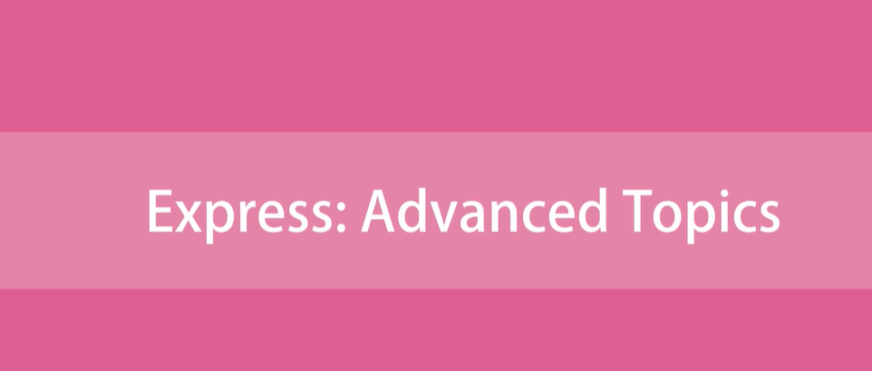

Slide 2
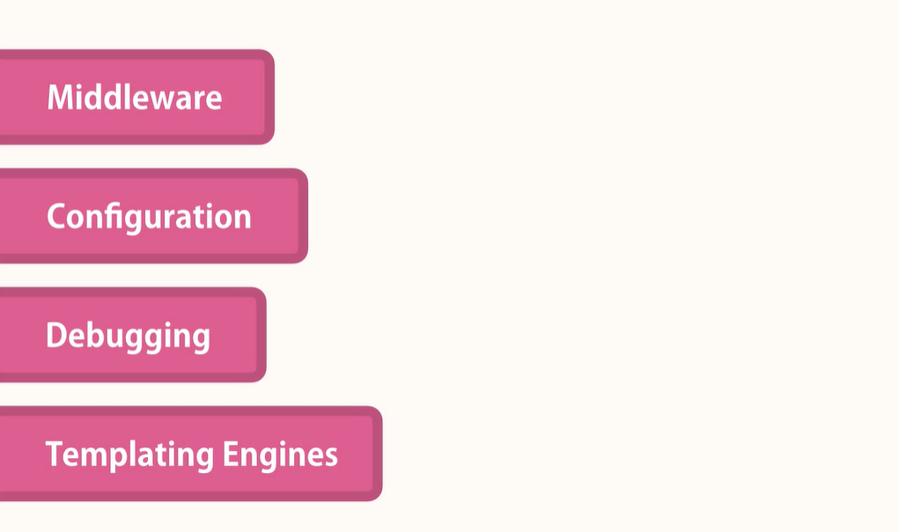

Slide 3
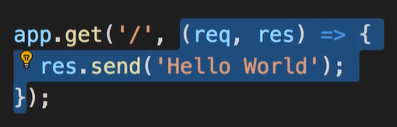

Middleware
Middleware function is basically a function that takes a request object, and either returns a response to the client or passes control to another middleware function.
The job of this middleware function is to read the request and if there is json in the body to parse it to json object and then
Set req.body = to this json
The route handler function that we already see in express is technically a Middleware.

Slide 4
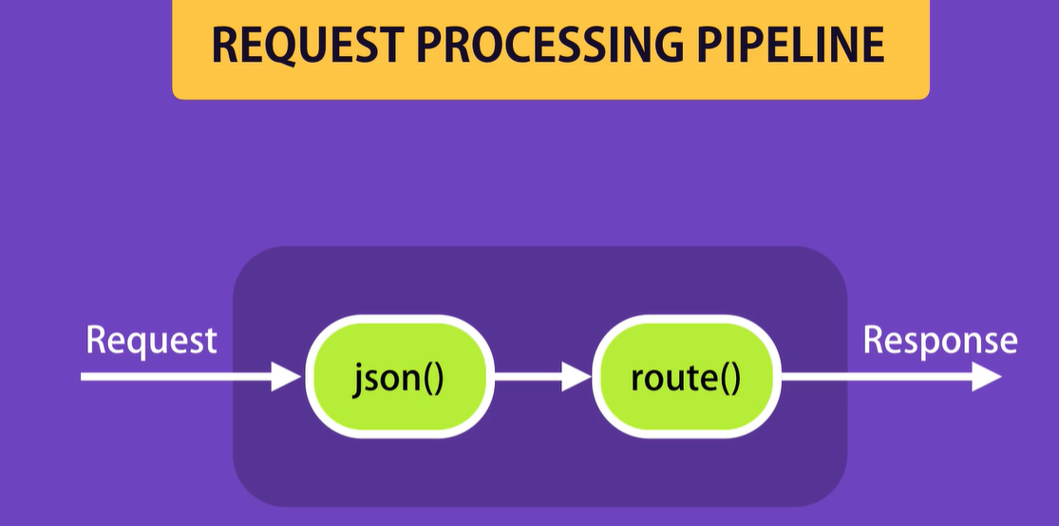
In current implementation we have 2 middleware's functions

Slide 5
Express is bunch of middleware functions

Slide 6
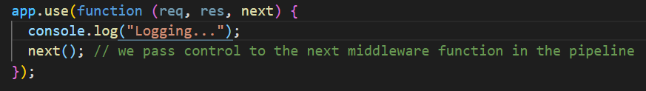
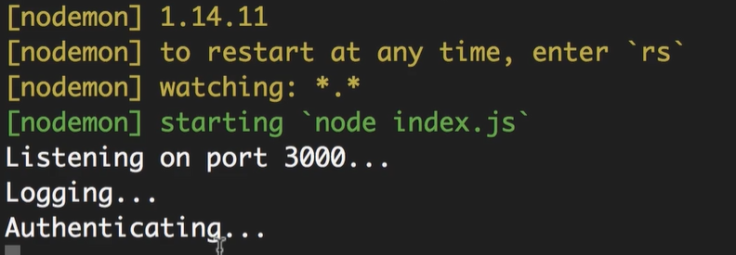
Creating Custom Middleware
If we comment next(). We don’t pass control to another Middleware function
To terminate the request response cycle. Our requests end up hanging there!

Slide 7
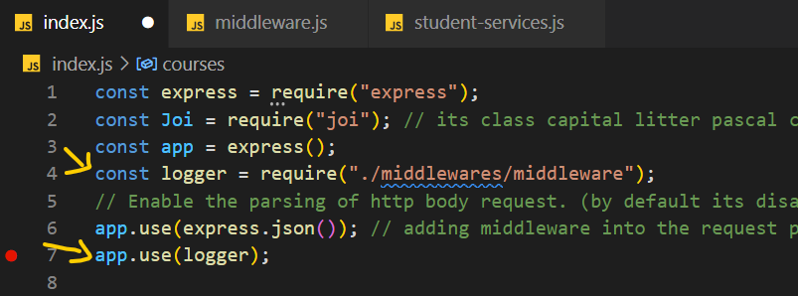
Moving the middleware to external module
Know u can understand exactly what express.json() is.

Slide 8
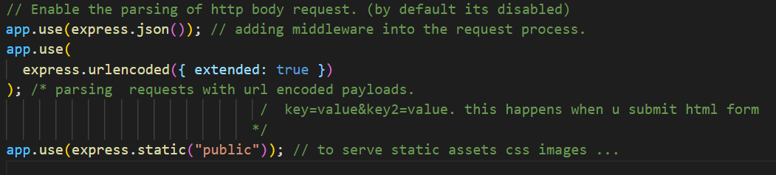
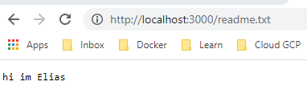
Built-in Middleware

Slide 9
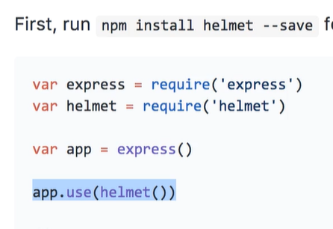
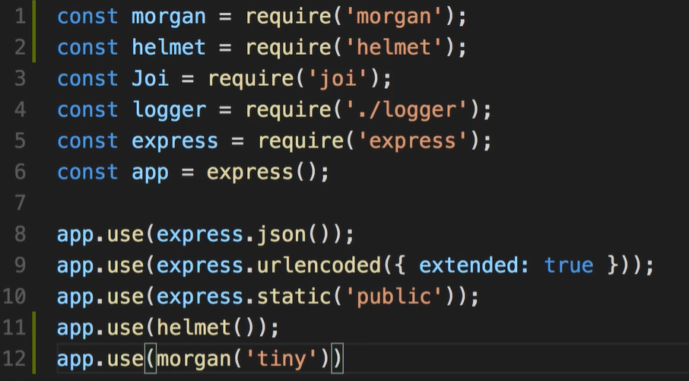
Third-party Middleware
Check helmet & morgan package for example
Link

Slide 10
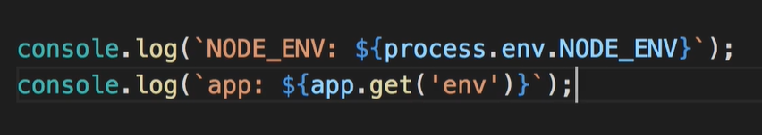
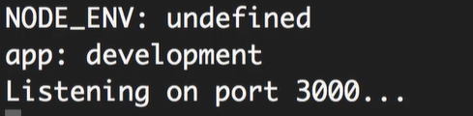
Environments
Enable or disable certain features based on environments.
Process object in node that give us access to the current process.
We can set it whatever we want development, staging, testing, production.
Get the current environment
process.env.NODE_ENV by default its undefined app.get(‘env’) by default its development.

Slide 11
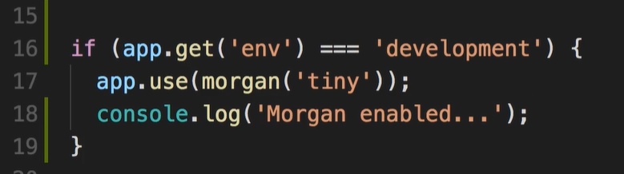
Environments
Example if using the env settings:

Slide 12
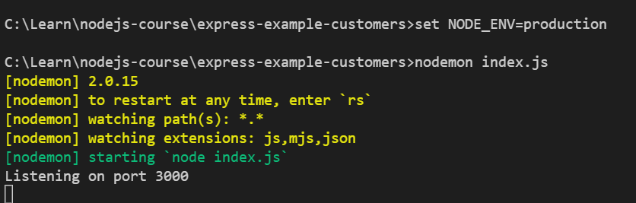
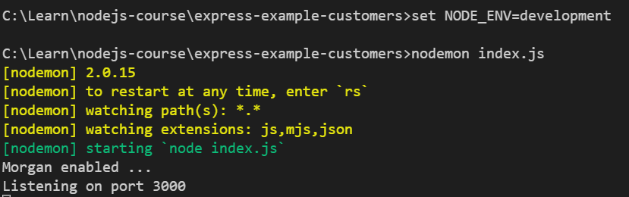
Set environments variables
We use set in windows and export in mac.
With production env
With development env

Slide 13

Configuration setting for the application
Most popular npm package for managing configuration is rc
Npm config is easier and cleaner that I personally like.

Slide 14
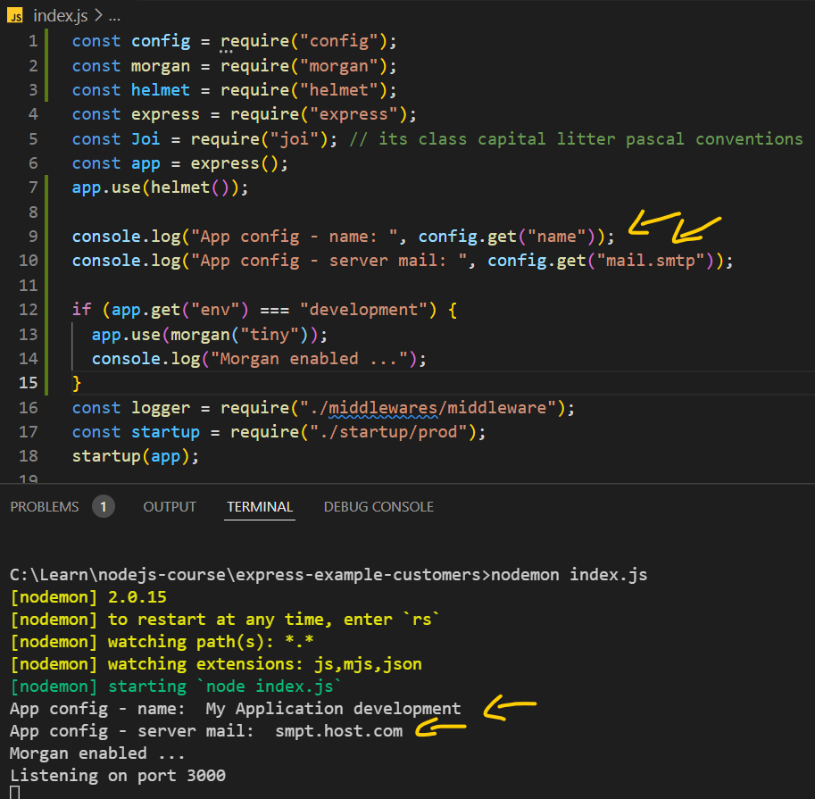
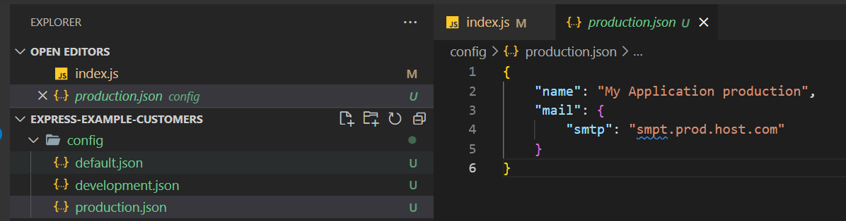
Configuration setting for the application
Setting env as development
We can set several configurations settings, default json will be the default values of the configurations.
Dev and prod config will override the default one.

Slide 15
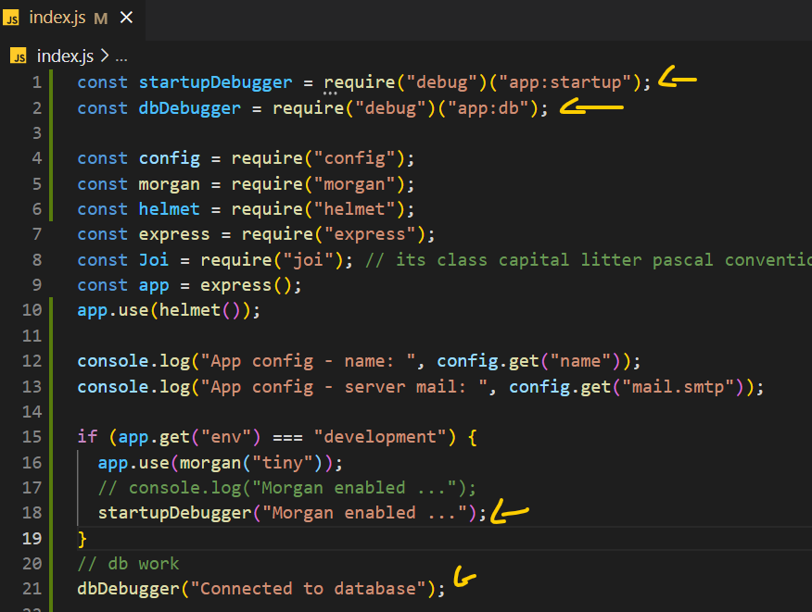
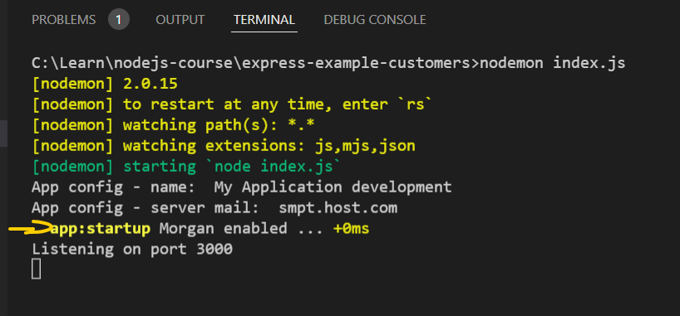
Debugging
Install debug package.
Enabling debugging based on the DEBUG variable

Slide 16

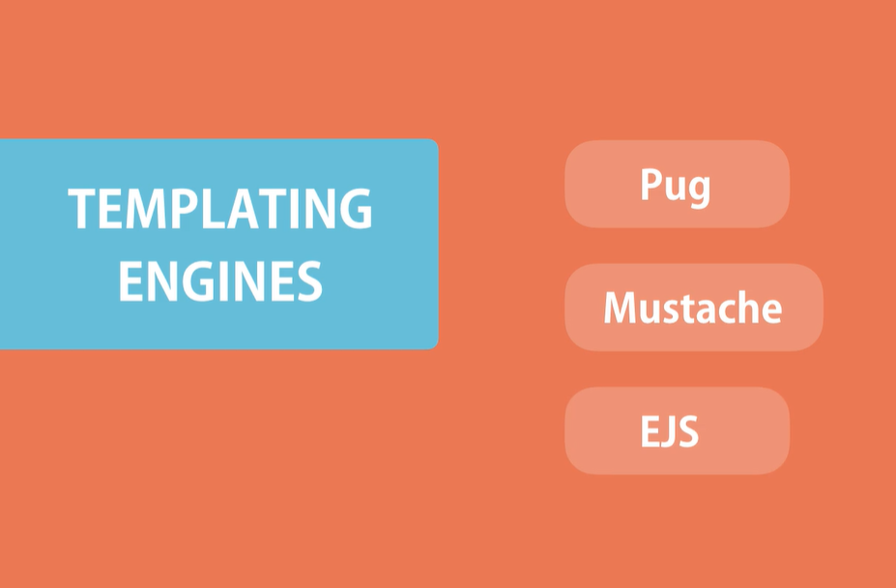
Templating Engines
Sometimes we need to return a HTML to the client and not JSON.
Top 3 most used templating engines in Nodejs.

Slide 17


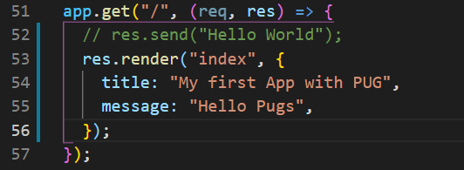
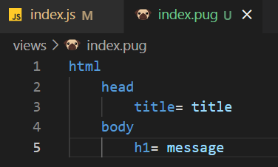

Templates Engine with Pug
Setting pug as view engine, as u see we didn’t require this package in this way when we set the view express will load it automatically
Nested of send in express we use render in order to return html

Slide 18

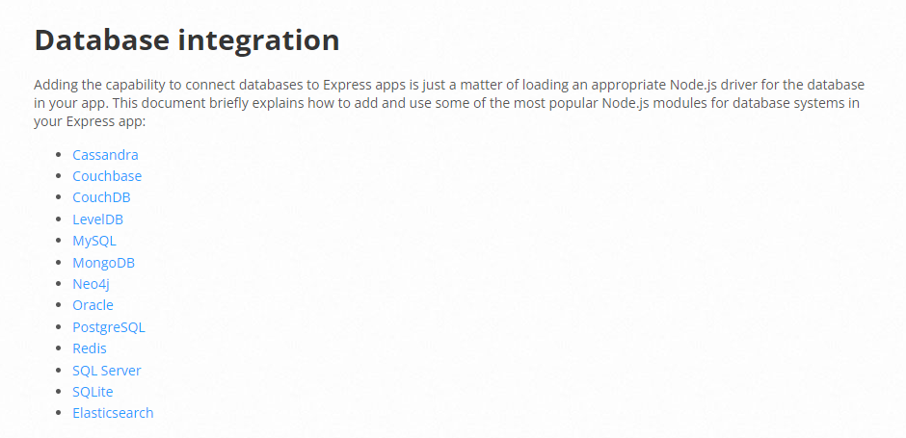
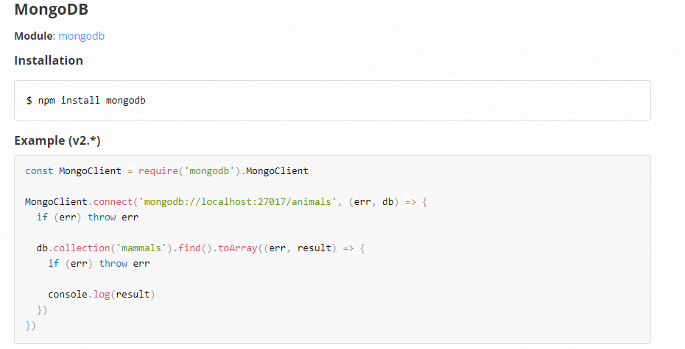
Database integration
what out various database integration options available for u when use Node and express
LINK

Slide 19
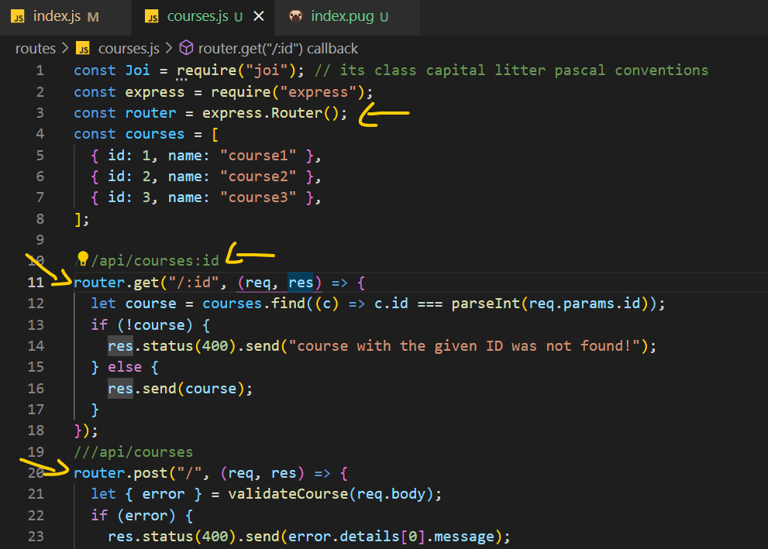
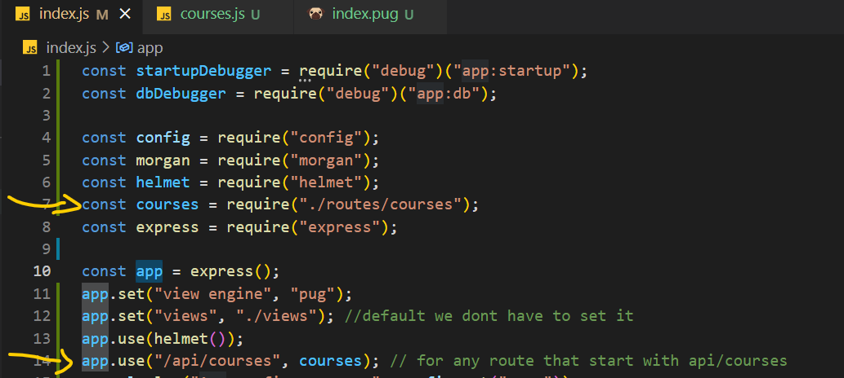
Structuring Express Applications
All the routes that working with courses will be moved to courses.js
All the routs let assume we have authors will be moved to authors.js

